Slide 1
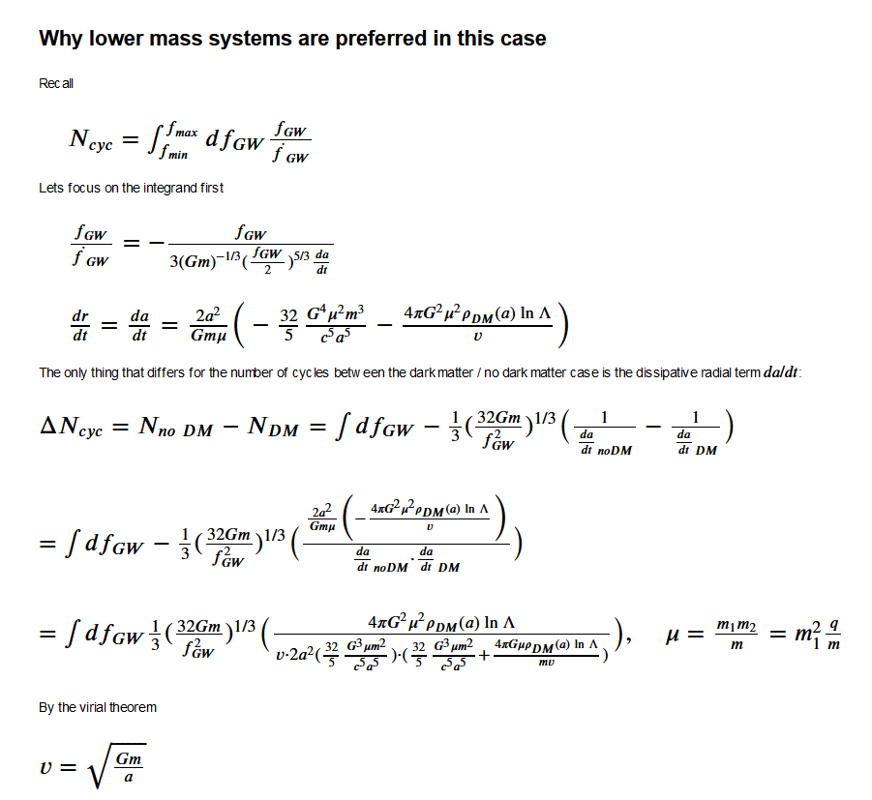
Similar Mass Analysis
First; the number of cycles

Slide 2
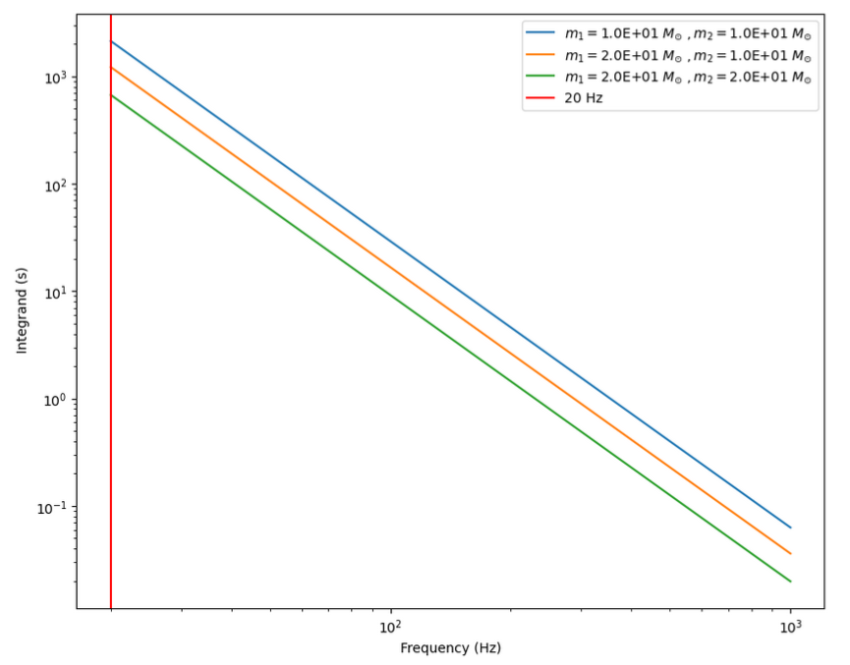
Similar Mass Analysis
First; the number of cycles

Slide 3
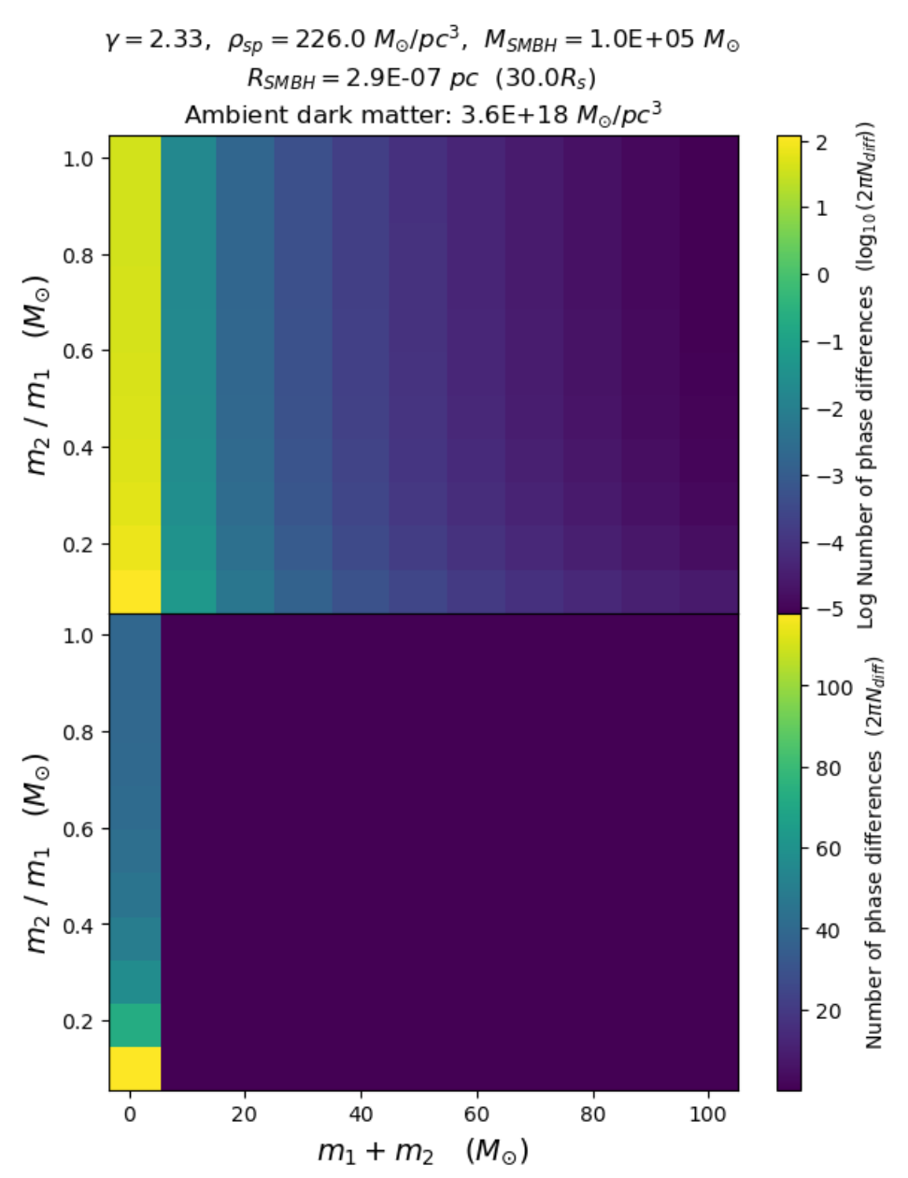
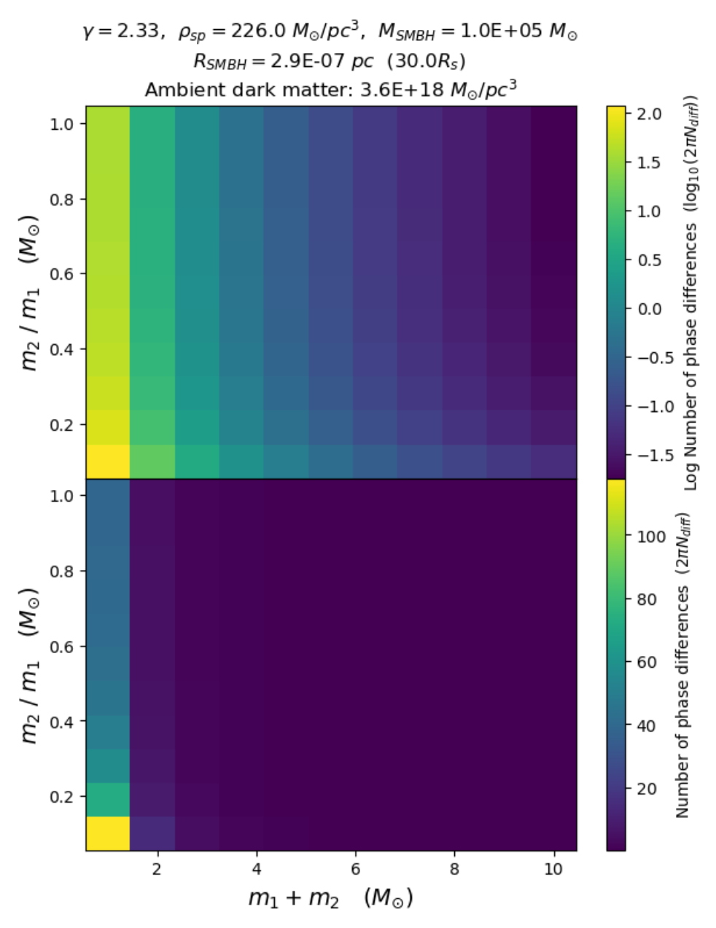
Similar Mass Analysis
Spike density ρ_sp : https://arxiv.org/pdf/2002.12811.pdf
Spike index γ (2.25 – 3): https://arxiv.org/pdf/1408.3534.pdf

Slide 4
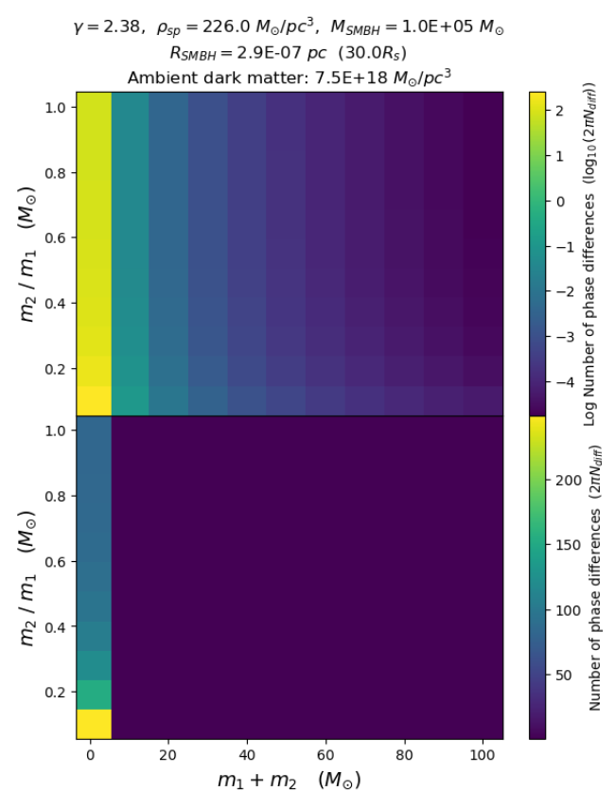
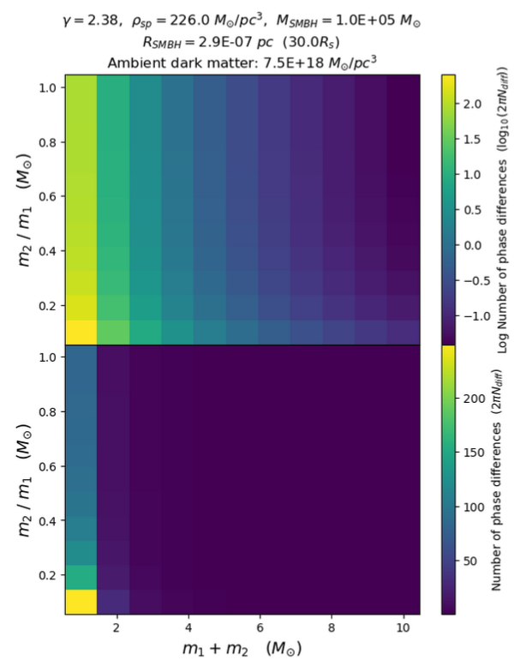
Similar Mass Analysis

Slide 5
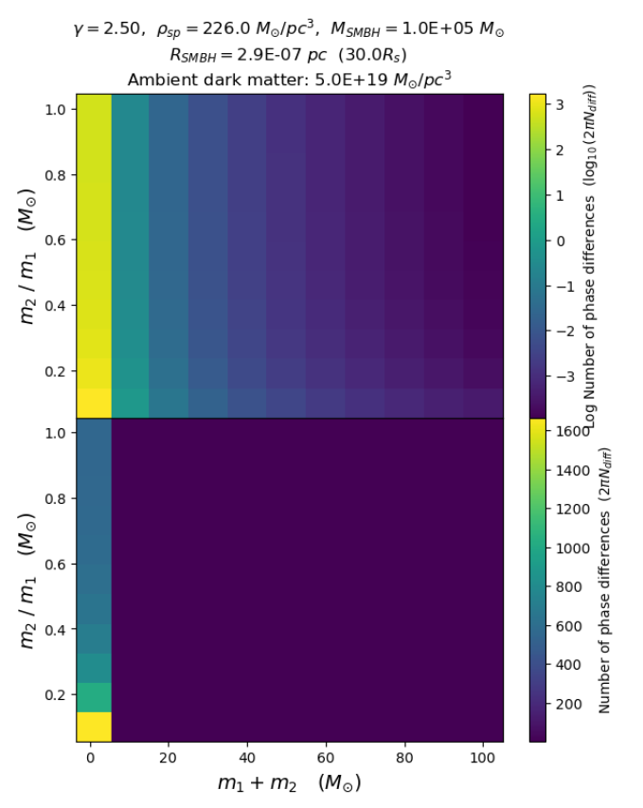
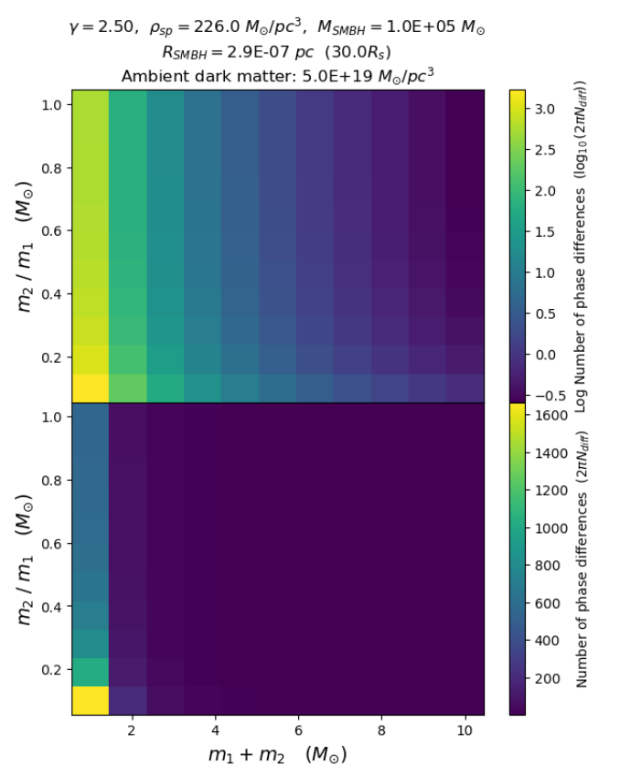
Similar Mass Analysis

Slide 6
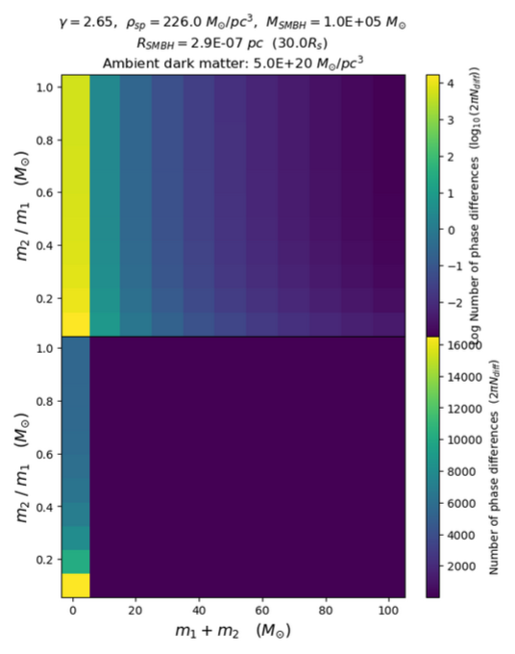
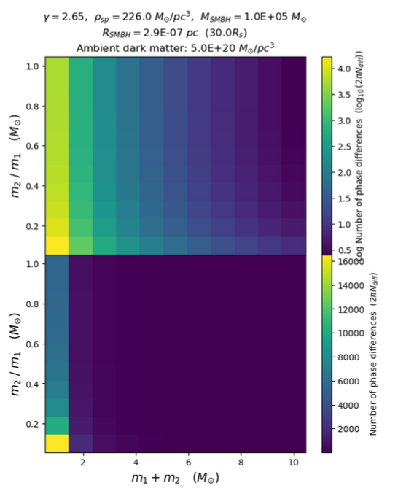
Similar Mass Analysis

Slide 7
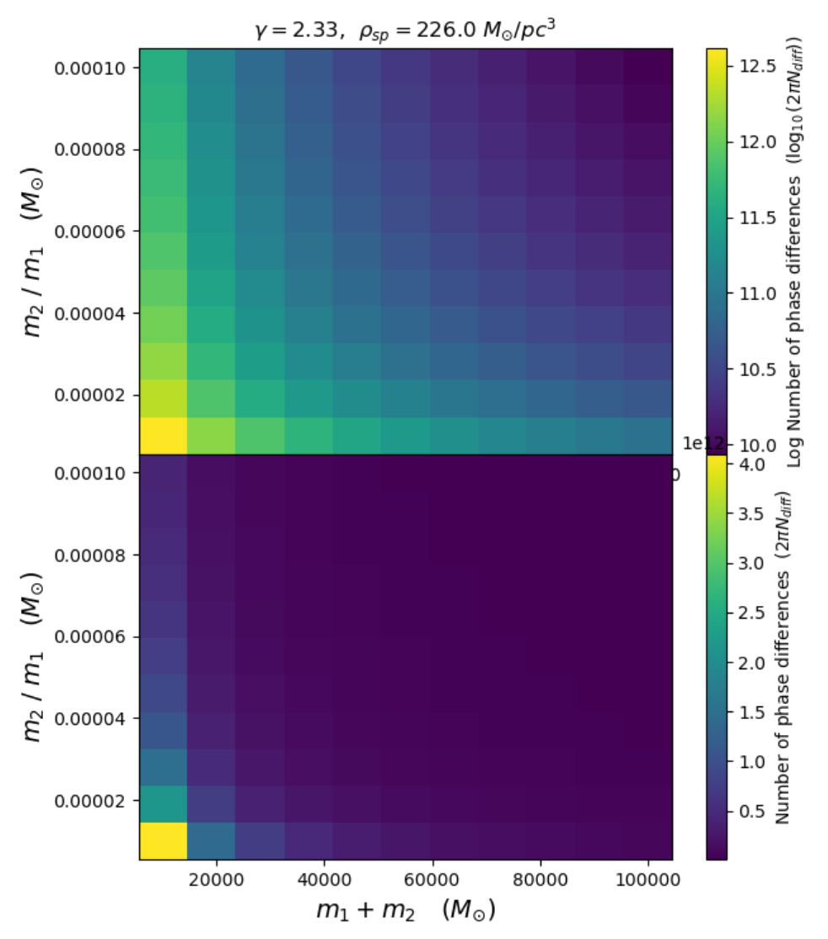
EMRI Analysis

